Slide 1




AtliQ Hardware
Brick & Mortar + Ecommerce
By : Piyush Tikiya

Slide 2

AtliQ Hardware
Sells
Printer
Mouse
Keyboard
Monitor
Hard Disk
Across
India
Other countries

Slide 3


Business Model
AtliQ
Retailors
AtliQ
Direct
AtliQ
Distributors
Ecommerce
Brick & Mortar
AliQ Hardware
Sore
AtliQ Hardware
Exclusive
Neptune
Amazon
Chroma
Sage
Novus
Kem- Choo
Babu
Teri-Naki
Final Consumers

Slide 4
Handling Big Data the Smart Way: AtliQ Strategic Move
Over time, AtliQ has been rapidly expanding its business across global markets. With this growth, the volume of data generated has skyrocketed.
Earlier, Excel was the go-to tool for storing and analyzing this data. But as the data grew in size and complexity, Excel started showing its limitations:
Slow performance ❌
File corruption risks ❌
Collaboration issues❌
Row/column limits ❌
That’s when the business recognized the need to shift to a more robust and scalable solution
MySQL Database ✅
Why MySQL?
Handles millions of records with ease
Ensures fast query performance
Supports multi-user collaboration
Highly secure and reliable for enterprise data
This transition not only solved the performance issues, but also opened doors to advanced analytics, real-time dashboards, and data-driven decision making for AtliQ.

Slide 5


Analysis the Finance View of AtliQ Hardware
Gross Price
Net Invoice Sales
Pre Invoice deductions
Post Invoice Discounts
( Promotional Offers + Placement Fees +Performance Rebate )
Net Sales
COGS
( Manufacturing Cost+ transport Cost + Other Cost )
Gross Margin
Gross Margin %
AtliQ Hardware follows fiscal year from 1 sept to 31 Aug.

Slide 6
Task
Croma India product wise sales report for fiscal year 2021
Description,
Generate a report of individual product sales (aggregated on a monthly basis at the product level) for Croma India customers for FY=2021 so that to track individual product sales and run further product analytics on it in excel.
The report should have the following fields,
Month
Product Name
Variant
Sold Quantity
Gross Price Per Item
Gross Price Total

Slide 7
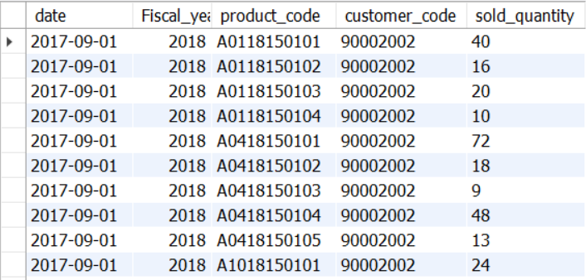
Querying Financials
first grab customer codes for Croma India
Select * from dim_customer Where customer like '%Croma%';
Search for transactions for that customer code
Select * from fact_sales_monthly Where customer_code = 90002002;

Slide 8
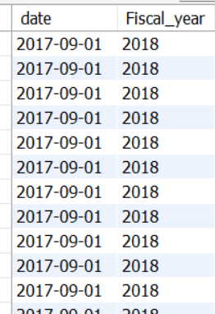
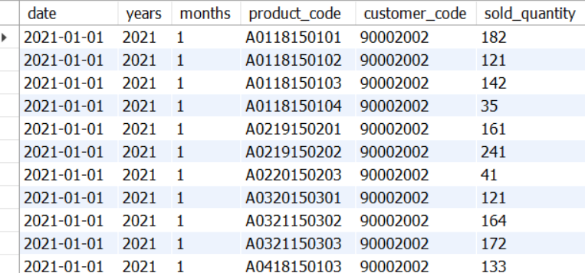
Querying Financials
Converting calendar year into fiscal year
select Year(Date_add(date, interval 4 Month)) from fact_sales_monthly;
Data needed only for year 2021
select date, year(date) as years,month(date) as months,product_code, customer_code,sold_quantity from fact_sales_monthlywhere customer_code = 90002002 and year(date) = '2021' and month(date) in (1,2)order by months, years;

Slide 9
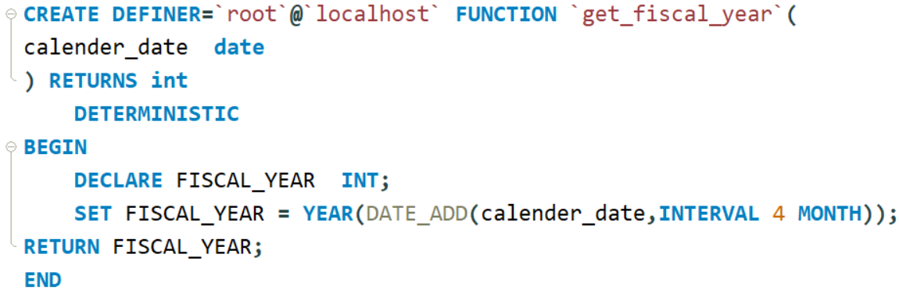
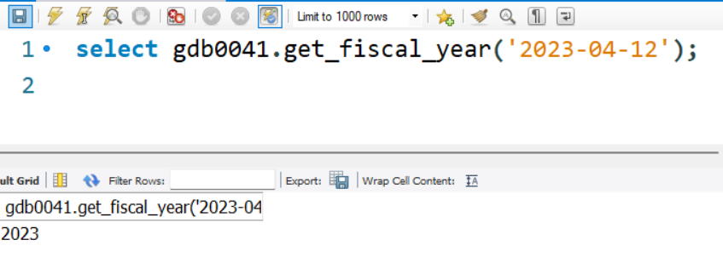
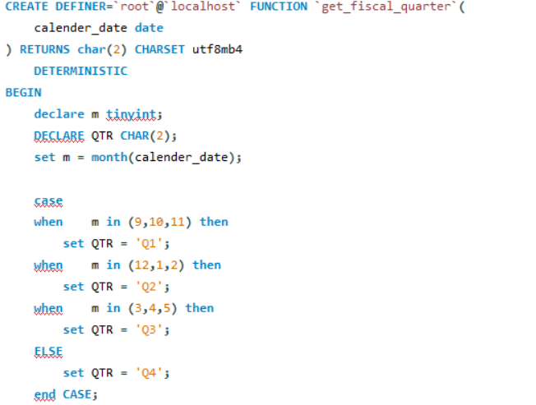
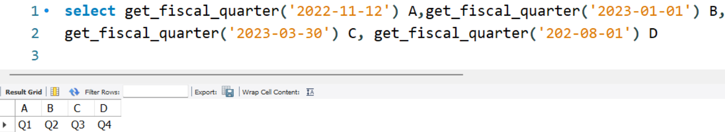
Dynamic Function
Creating function get_fiscal_year for dynamic user selection
Creating function get_fiscal_quarter for dynamic user selection

Slide 10
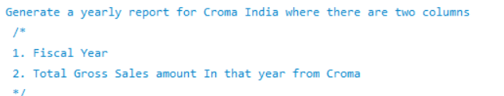
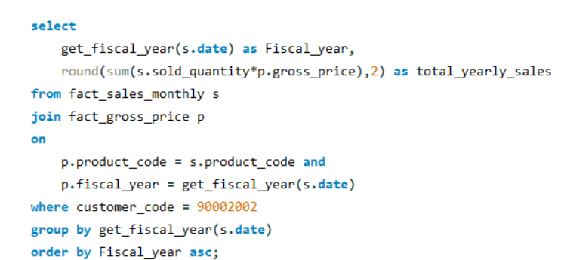
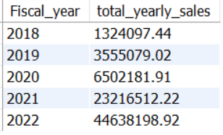

Slide 11
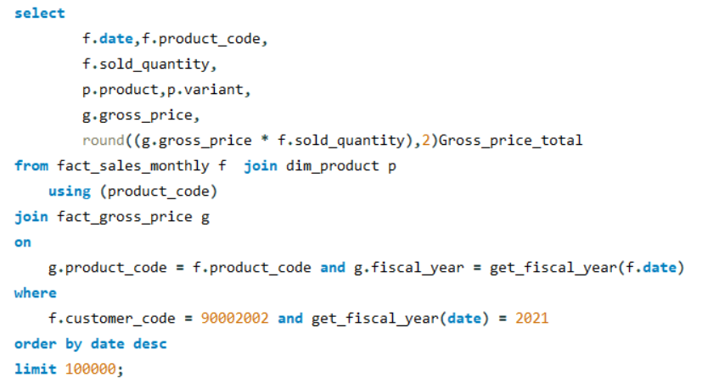
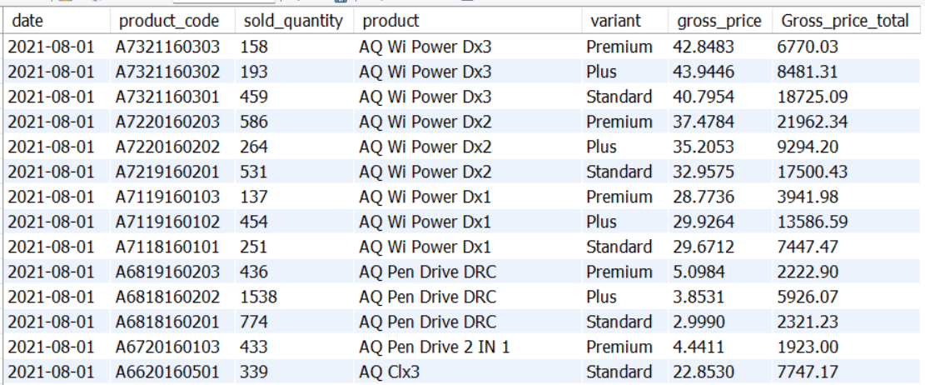
Performing join with dim_product table to get productname and variant
Calling Function In the Query

Slide 12
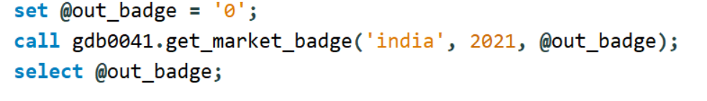

Automate Query with Stored Procedure
Initially, this report was static and specific to one customer.
Now, I have automated this process by creating a stored procedure, allowing the customer_code to be passed dynamically. This makes the report generation reusable for any customer, enabling better flexibility and scalability.
CREATE DEFINER=`root`@`localhost` PROCEDURE `get_market_badge`(
IN in_market varchar(50),
IN in_fiscal_year year,
OUT out_badge varchar(50)
)
BEGIN
DECLARE total_qty INT DEFAULT 0;
# Default market is India
IF in_market = "" THEN
SET in_market="India";
END IF;
# Retrieve total sold quantity for a given market in a given year
SELECT
SUM(s.sold_quantity) into total_qty
FROM
fact_sales_monthly s
JOIN
dim_customer c ON s.customer_code = c.customer_code
WHERE
GET_FISCAL_YEAR(s.date) = in_fiscal_year and market = in_market
group by c.market;
# Determine Gold vs Silver status
IF total_qty > 5000000 THEN
SET out_badge = 'Gold';
ELSE
SET out_badge = 'Silver';
END IF;
END

Slide 13
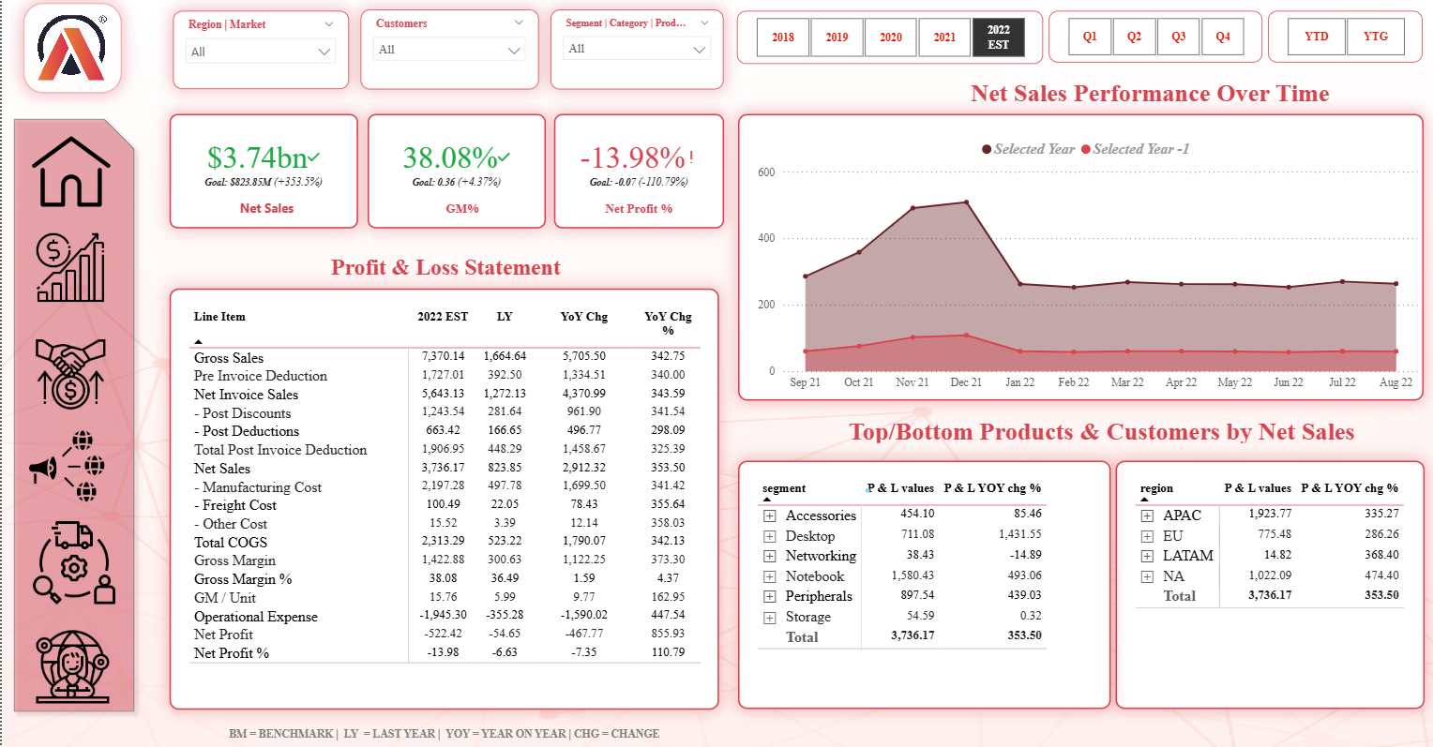
Dashboard – Finance View

Slide 14
Thank You

